Slide 1
General Digital Accessibilty Principles
Siteimprove Instructor-led Training

Slide 2
Objectives
Ability awareness
Guidelines and Roles
Accessible Digital Content
Notes:
Our goals today are to:
Ability Awareness
Guidelines and Roles
Accessible Digital Content

Slide 3

Start with accessibility in mind
Notes:
Usable, accessible, and beautifully integrated design. How did they accomplish that? Started with accessibility in mind.
Robson Square, Vancouver, Canada

Slide 4
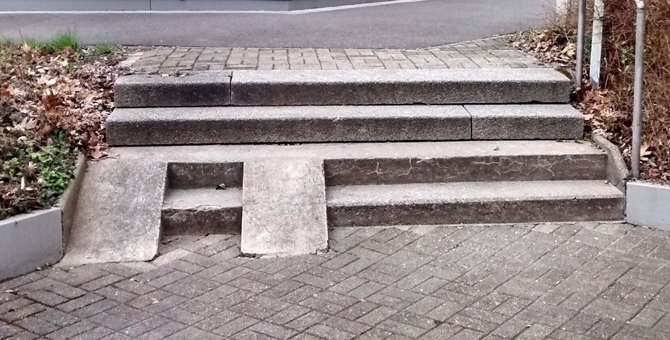
Add accessibility later
Notes:
This example shows a small set of stairs that didn’t consider accessibility and had no ramp. Someone tried to add a ramp, but only managed to make it half way up the stairs. This is not effective. This is what can happen when you try to add accessibility later as a band aid.

Slide 5
Ability Awareness
Act with Digital Certainty
Notes:
Ability Awareness

Slide 6

5 Myths about Accessibility
Accessibility doesn’t affect many people
Only experts can implement fixes
You don’t have to worry about it until you get a request
Accessible design interferes with general design and layout
You are not required to fix because it’s cost prohibitive
Notes:
Helps those beyond the able of “disabled”. Broken links, colors, captioning, unable to hear audio
Many fixes are simple and can be implemented when the content is created. Tools available to help.
An ounce of prevention is worth a pound of cure. Going back to “find” the issue can be time consuming.
Accessible websites are often unperceivable from inaccessible sites. Sites do not have to be text only to be complaint. Often times I you create an alternate site that is simple, updating it will not be in parallel with the main site. Can be forgotten.
According to the HHS.gov website, the cost to fix the issue must exceed more than 5% of the total HHS discretionary budget. TAMU doesn’t have this type of ruling.

Slide 7

Ability Awareness Examples
Learning Disabilities
  Attention Deficit Hyperactivity Disorder (ADHD)
  Dyslexia
Visual Impairment
  Color Deficiency
  Low Vision
  Blindness
Hearing Impairment
  Hearing loss
  Deafness
Physical Limitation
  Dexterity
  Temporary Conditions
CDC Infographic

Slide 8
Why Web Accessibility Should be a Priority Now
The aging population is predicted to triple to 1.5 billion by 2050
23% of web accessibility-related litigation and settlements since 2000 happened in the past three years
Mobile screen reader usage has increased by 70%

Slide 9


Do You Use Accessibility Features?
Closed captions
Screen lighting/color filters
Voice to text
Predictive text/keyboard shortcuts
Zoom or magnifier
Font adjustments
Visible or vibrating alerts
Safari reader (reduces clutter)
Notes:
Technology makes things easier for most of us, but in the case of persons with disabilities it makes things possible (independent living, social interactions, pursue education)
But according to Google's accessibility UX researcher Astrid Weber, there are two kinds of disability.
There are the people who are permanently disabled, and then there are those who are "situationally disabled." Situational disability can be as serious as a broken arm or as temporary as having your hands full with shopping bags.
The point is that all users are situationally disabled on a regular basis, which means that accessibility features are for everyone.

Slide 10





Assistive Technology
Notes:
Assistive Technology includes assistive, adaptive, and rehabilititative devices that may be a piece of equipment, software program, or product system.
What comes to mind when we use the term assistive technology? Take a moment to think about types of assistive technology you may have heard of, used, or known people with disabilities to use. Screen reader software, braille terminals, braille keyboards, screen magnification software, speech recognition software, keyboard overlays, mouth sticks, and switches are some common types of assistive technology that may be used for web browsing and interacting with websites.
Benefits of ‘inclusive’ Accessible Websites
Higher conversion: the more users that can understand and access your content the more you are likely to convert.
Mobile friendly: accessible websites built to global accessibility standards are primed for responsive layout displays.
SEO: Screen readers and other assistive technologies, like Google, can better understand them.
SEO: Content layouts are well structured for on page search engine optimisation.
Loyal consumers: In a competative web environment with so much competation at stake and so much unaccessible content out there, accessible websites will benefit from the loyalty of a increasingly growing disabled community, accounting for approximately 20% or 1.2 billion people globally.

Slide 11
Visual Impairment: Low Vision or Blindness
Visual impairment is often defined as best corrected visual acuity of worse than either 20/40 or 20/60
As of August 2014, 285 million people are estimated to be visually impaired worldwide
  246 million with low vision
  39 million with blindness

Slide 12




Screen Readers

Slide 13

Temporary Limitations
Unable to use a mouse
Need a smaller or larger keyboard
Brightly or dimly lit environment
Noisy bus or train
Broken arm

Slide 14
Guidelines and Roles
Guidelines and Legal Considerations

Slide 15
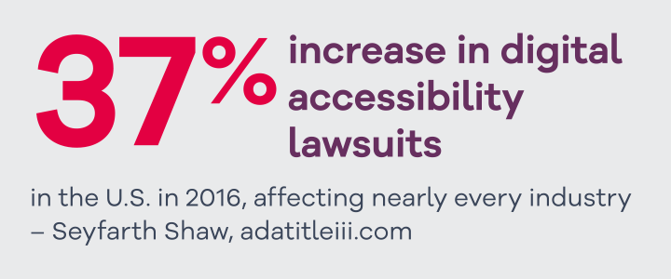
Notes:
37% increase in digital accessibility lawsuits in the US in 2016 affecting nearly every industry quote from Seyfarth Shaw

Slide 16
History of W3C Standards and Recommendations
HTML 4.0, December 1997
HTML 5, October 2014
HTML 5.1, November 2016
CSS 1, December 1996
CSS 3, 1999
WCAG 1.0, May 1999
WCAG 2.0, December 2008
WCAG 2.1, Draft 2017
WAI-ARIA 1.0, March 2014
Notes:
This slide highlights the major milestones for HTML, WCAG, CSS and ARIA.

Slide 17
Web Content Accessibility Guidelines
Perceivable
Operable
Understandable
Robust
Everyone can “see” it
Everyone can operate it
Everyone can understand it
All devices can use it
http://www.w3.org/WAI/intro/components.php
Notes:
https://www.w3.org/WAI/WCAG20/quickref/
WCAG 2.0 is the current recommended standard for TAMU. There are 12 guidelines under four principles (high level):
62 specific success criteria
Level A — 26 success criteria
Level AA — 13 success criteria
Level AAA — 23 success criteria
Perceivable – can everyone “see” this?
Provide captions and other alternatives for multimedia.
Provide text alternatives for non-text content.
Operable – can everyone operate this?
Make all functionality available from a keyboard.
Help users navigate and find content.
Understandable – can everyone understand this?
Make text readable and understandable.
Help users avoid and correct mistakes.
Robust – can all devices use this?
Maximize compatibility with current and future user tools.
Write good code.

Slide 18
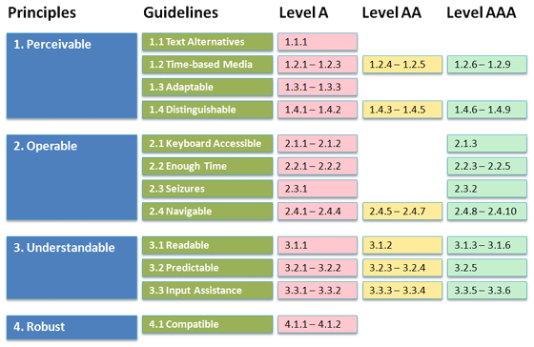
Level of Compliance
Notes:
Level A has 25 success criteria and level AA has 13.
Level AAA has an additional 23!!
https://www.w3.org/WAI/WCAG20/quickref/
Section 508 of the Rehabilitation Act
Section 255 of the Telecommunications Act
Americans with Disabilities Act
The 21st Century Communications and Video Accessibility Act
World Wide Web WCAG 2.0 (Web Content Accessibility Guidelines)
What’s helpful?
The following two documents can be used to help understand and achieve the various levels of conformance set out by the WCAG.
Understanding WCAG 2.0
A guide to understanding and implementing Web Content Accessibility Guidelines 2.0.
Techniques for WCAG 2.0
Techniques and Failures for Web Content Accessibility Guidelines 2.0.

Slide 19
Legislation
Australia - The Disability Discrimination Act
Canada - Canadian Human Rights Act of 1977 and The Canadian Charter of Rights and Freedoms
European Union – Directive (EU) 2016/2102
United States of America - Section 508 of the Rehabilitation Act of 1973
Notes:
The WCAG 2.0 are the recognised international standard for web accessibility but they are not, in their own right, legally binding.
The WCAG form the technical kevel of conformance for various regional and national legislation including.

Slide 20
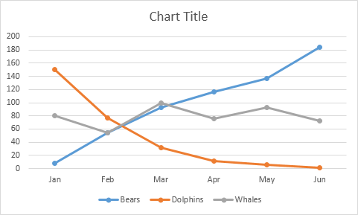
Scenario: Inaccessible Image
Notes:
Does anyone here think the web developer is the primary person responsible for accessibility?
If an issue is found that an image does not have accurate alternative text, the fault could be:
The content provider did not mark up/code properly by providing alternative text for the image.
The developer used a plug-in that didn’t have correct accessibility mark up/code.
The purchaser did not buy a product that had accessibility features built in to avoid this error.
The leadership did not require everyone to know the importance of accessibility.

Slide 21

Roles
Notes:
https://www.w3.org/community/wai-engage/wiki/Accessibility_Responsibility_Breakdown
Leadership
Procurement
Champion
Project Management
Interaction Design (Designer)
Visual Design (Communications/Marketing)
Content Contributors (Editors/Writers)
Developers (Front end/Back end)
Quality Control (QA)

Slide 22

Leadership Role
Position:
CIO, CEO, Executives, Directors, VPs, General Counsel, Compliance Officers
Responsibilities:
  Understand legal implications
  Make accessibility a strategic priority
  Allocate budget and time to implementation
  Institute accessibility policies
Notes:
If you are responsible for managing staff, be sure they understand the importance of ensuring accessibility and have access to the training about accessibility compliance.
Research and understand state and federal accessibility legislation. Including current legal actions.
Set the expectation that accessibility is mandatory. Set benchmarks and timelines for compliance.

Slide 23

Procurement Role
Position:
Contract Administrator, Contracts Manager, IT Purchaser
Responsibilities:
  Include accessibility requirements for contractors
  Use accessibility as part of selection process
  Enforce accessibility contract requirements
  Follow accessibility contracting requirements for software and equipment
Notes:
Websites are developed and maintained in any number of ways. Some sites are managed entirely in-house, while many companies rely on outside agencies for different services.
Develop and use vendor contract language about accessibility for purchasing and procurement.
Additionally, ICT requires accessibility compliance inside your organization for staff, as well as for external customers.
Often times, a purchaser or buyer will need to evaluation similar companies based on a set of factors, like cost, reputation, and/or services provided.
Accessibility should be a contributing factor in this process.
Consider, if you choice a competitor with a low cost and low accessible products, you may find that you lose more money trying to make the product accessibility or through lost business and customer complaints.

Slide 24

Champion Role
Position:
EIR, Accessibility Coordinator, Policy Analyst, Team Lead
Responsibilities:
  Act as point of contact for accessibility compliance issues
  Advocate for accessibility issues
  Lead the charge
  Document progress and provide reports
Notes:
Act as a point of contact for internal and external inquiries regarding issues of compliance.
Extensive knowledge and experience with accessible web design, principles of Universal Design and understanding of accessibility issues related to emerging web technologies, multimedia and learning environments
Commitment to accessibility issues
Create task force and work groups
Examples: EIR, Accessibility Coordinator

Slide 25

Project Management Role
Position:
Project Leader, IT Development, Delivery Manager, Operations Manager, Program Managers
Responsibilities:
  Be aware of how accessibility impacts projects
  Include accessibility in the beginning
  Plan each step of web development lifecycle
  Document requirements, wireframes, and prototypes
Notes:
If you are responsible for planning a project or managing a program, remember to allow time for accessibility and usability review for your digital content.
While the project manager (PM) does not directly impact implementing the different Success Criteria from WCAG 2.0, they play a vital role in making sure every project stakeholders understands their role during project development and planning accessibility at each step of the web development lifecycle
Software and tools development.
During development of a new tool or especially during a website redesign, you need to be very precise in when you address accessibility.
If you are baking blue berry muffins, it's easier, faster, and less messy to add them at the beginning of the recipe, rather than trying to add them after the fact. The same can be said for accessibility.
If your developers and designers understand the options available through accessible design in the beginning, they will not be trying to force items in at the end.

Slide 26

Interaction Designer Role
Position:
Interaction Designer, UX Designer, Web Designer
Responsibilities:
  Focus on usability, accessibility, and standards
  Be aware of how accessibility impacts design choices
  Make interactions that work for all users
Notes:
The graphics design function covers tasks and related quality control normally associated with the graphic design of interfaces, the related graphic declinations, the specific design of navigation elements, context changes and other general design of the main content of the pages.
The graphic designer may or may not directly interface with the web application, but they need to know the best practices when laying out and designing elements.
Graphic Designers play a key role in website redesigns and site usability.

Slide 27

Visual Designer Role
Position:
Graphic Designer, Marketing Manager, Marketing Specialists
Responsibilities:
  Use accessible fonts, images, and color choices
  Be aware of how accessibility impacts visual choices
  Create clear interactions
Notes:
Marketing Managers make decisions about branding, like fonts and color choices. These decisions have an image on accessibility when related to things like color contrast ratios and readability.
Color cannot be used to convey meaning alone. Think about color in graphics or charts and how a color deficiency can restrict understanding.
Images are a big part of marketing. Marketing Manager need to be aware of how these images are used in a digital environment.
Make sure links are easily distinguished and have focus.
Examples: Communications Director, Marketing managers/directors, agencies, search specialists, etc.

Slide 28

Content Contributor Role
Position:
Editor, Writers, Instructional Designers, Content Managers, Document Creators
Responsibilities:
  Create content that will be put on a website
  Add visual interest with images and graphs
  Create multimedia files for engaging experience
Notes:
If you create files that may be distributed through email, posted online, or shared through another electronic format, you will want to know how to make your files accessible.
A content contributor is a user who can add items to a web page, but is generally not responsible for developing templates or applications.
Often in charge of things like:
Headings
Lists
Data tables
Links
Alternative text for images
Captions for audio and video files

Slide 29

Developer Role
Position:
Webmaster, Web Professional, Developer, IT Specialist, Engineer
Responsibilities:
  Strong understanding of guidelines and coding languages
  Develop the structure of the website
  Add interactions and control elements
  Embed plugins and third party integration
Notes:
Much of the technical requirements for accessibility rest in the hands of the developer. Need to work with HTML, CSS, ARIA, and Javascript.
If you managing or developing a website, you will need to follow accessibility guidelines for web content and monitor your content contributors.
The developer function covers tasks and related quality control normally associated with the development of contribution tools, HTML and CSS integration, and the programming of proposed scripts and applications on the Web site.
Navigation and templates make up the framework of the site. While the web designer determines placements and treatments, the Developer makes those layouts into a reality.
Develop forms and video control elements. Apply the things you don’t see like keyboard controls, tab order and bypassing blocks.
Utilize widgets like calendars, carousels, and photo galleries. Can be developed in-house or might leverage open source code.
Additionally, the developer function can cover the development of server side programing and database management.

Slide 30

Quality Control Tester
Position:
Quality Assurance Tester, Quality Control, Accessibility Tester
Responsibilities:
  Strong understanding of guidelines and coding languages
  Confirm accessibility compliance
  Test using assistive technologies
Notes:
The quality control function covers tasks normally associated with general validations at the very end of the project, before launching, and also responsible to regression testing.
This role must be able to test for and identify accessibility issues. It is best practice if they are familiar with testing using assistive technologies, like a screen reader.

Slide 31

We are in this together
We can all
do our part!
Notes:
We can all do our part. It’s a team effort.

Slide 32
Accessible Digital Content
Start with Accessible Content

Slide 33
Organized by Area
Content
Color
Adding assets: Links, images and tables
Menu and navigation
Forms
Robust code
Widgets and plugins

Slide 34
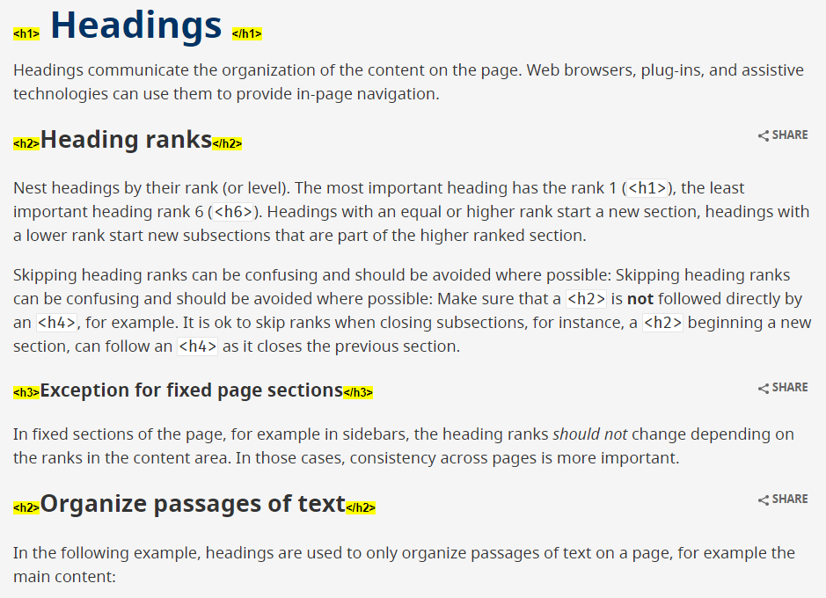
Headings
Leveraged by Search Engines
Highlights key information
Makes scannable
Used as navigation for screen readers
Notes:
Headings ((2.4.6))
Headings are used to provide a hierarchical structure to content on a webpage.
Do not pick a level for the visible appearance; it should follow the proper sequence
Establishes hierarchy from level 1 to level 6 (<H1>, <H2>, <H3>, <H4>, <H5>, <H6>)
Skipping heading levels is considered bad practice and should be avoided.
Heading level 1 should only be used once on a webpage.
Headings are used for navigating around a webpage.
Consistency of headings across the site provides clear structure.
Screen reader users have shortcuts to navigate through Headings to quickly access or understand the pages layout.
Benefits:
This structure and meaning is leveraged by Search Engines and increase page traffic.
Subsequent headings (H1-H6) highlights additional information sections on the page.
Makes content visibly scannable as well as adding navigation to the page for a screen reader user.

Slide 35
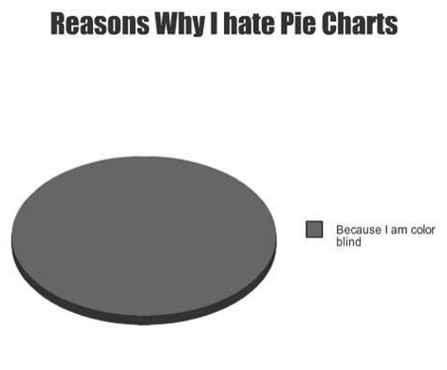

Color Deficiency
Notes:
Color deficiency (also called color blindness) affects approximately 1 in 12 men (8%) and 1 in 200 women in the world. This video by SSB Bart Group shows when color contrast testing is important.
This was tweeted by @Wethecolorblind. Their tag line “roses are gray, violets are gray…”

Slide 36
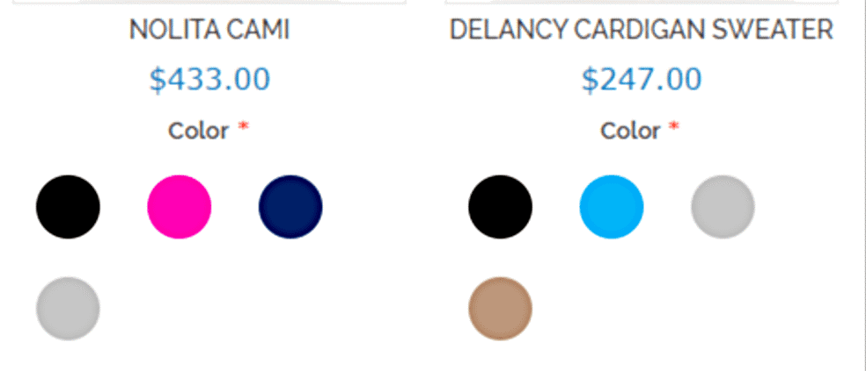
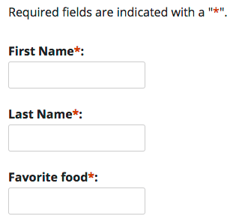
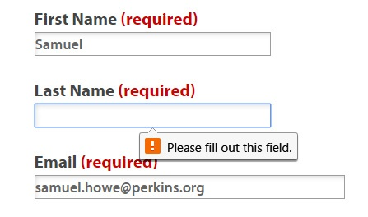
Color to Convey Meaning
Notes:
Don’t use color alone for meaning.
In graphs, place the legend directly in the chart
In graphs and maps, display the type of data for each element in a tooltip so it can be viewed on a mouse over [done with the a:hover tag] so color isn’t the only attribute
Use varied icons or varied shapes in addition to color for status icons or to indicate required fields
When users are required to select a color, name the color in text as well as showing the color
To sum it up: never use color alone to indicate anything!
Incidental: inactive user interface component
Logotypes: logo or brand

Slide 37


Take a Deeper Look
Can you tell which of these is accessible?
Notes:
You can’t always tell from the surface which items on your site are accessible. In this case, both of these form fields look accessible, but a key piece of information is missing for the screen reader user. Neither of these have proper labels on the form field. That means when a screen reader encounters them they only hear “form field empty.” Which makes it impossible to know what this field is requesting.
Often search and mailing list sign up are key tasks user do on your site.

Slide 38

Distinctive Links
Notes:
Screen reader users use links as a means to navigate a webpage, which means they are often taken out of context. Unique and distinctive text is really important for screen reader users.

Slide 39

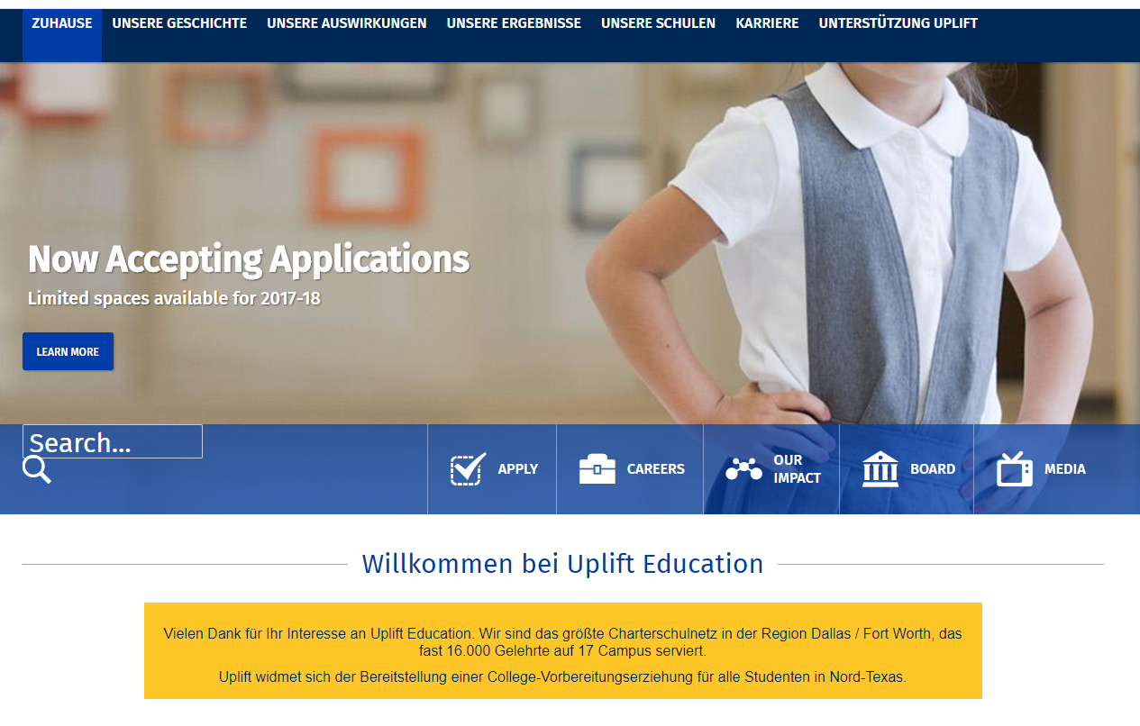

Text Inside Images
Notes:
Images with Text (1.4.5)
Whenever possible, images that include text should be avoided.
The first problem with using an image to show text is it takes away the accessibilityfor blind and visually impaired users that comes with text. For instance, a blind user might have a screen reader set up on their computer to read out the text and menu items for them.
When you must put text inside an image, take note that color contrast checkers can not automatically check these situations.
You will need to manually check that the text and image have enough contrast to be readable.
Also consider that Images often have a variety of colors and tones. While one part of the text may be easy to read, other parts are difficult.
Note: Keep in mind that images with text will also not zoom or resize without becoming pixelated. This can make reading even more difficult.
Images should not be used to present text
Common missuses: CAPTCHA, carousels, and ads
Avoid using images of text for headers; trying creating the same result with CSS
Logos are an acceptable exception
Note:
Text in images can not be read by a screen reader, important to have descriptive alternative text.
Images of text do not resize well and will look degraded when using zoom function or on mobile devices.
Readability is usually very low due to color and font choices.
Google Translates can’t change these words!

Slide 40
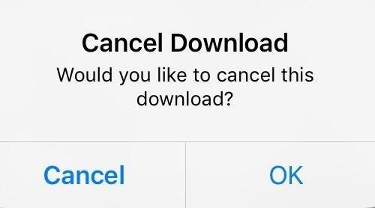
Clear

Slide 41

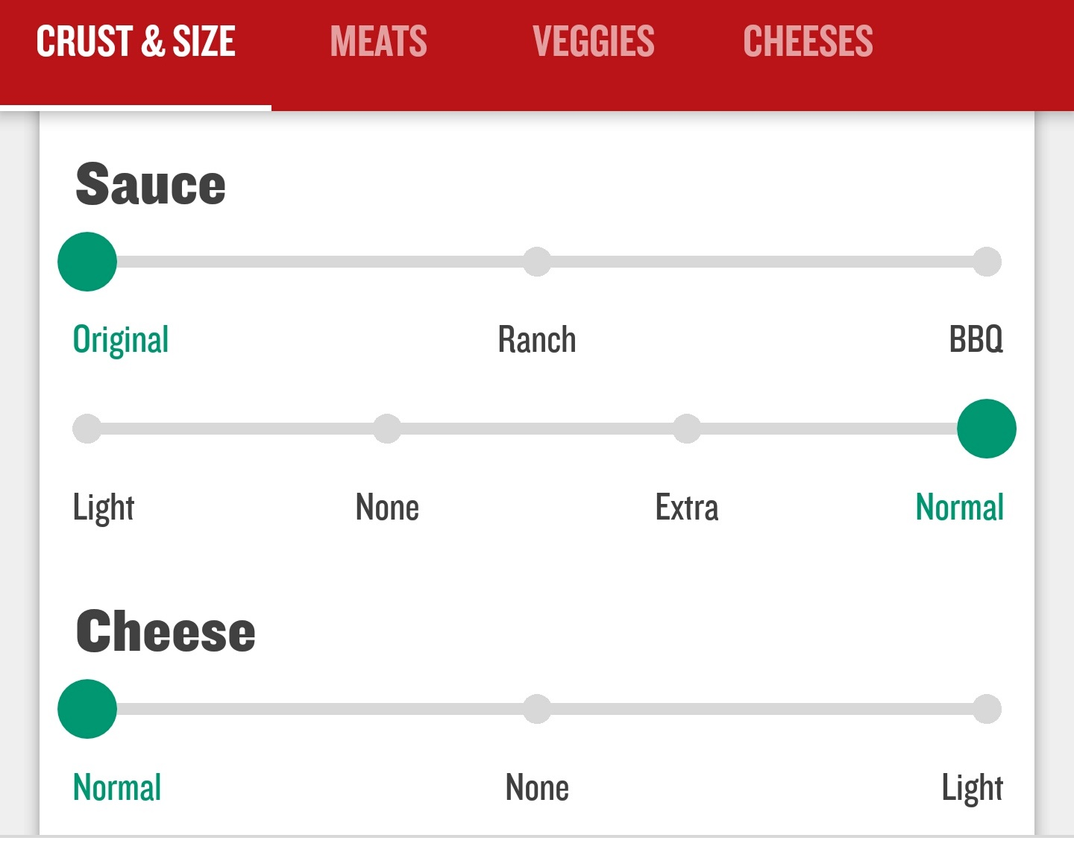
Predictable

Slide 42
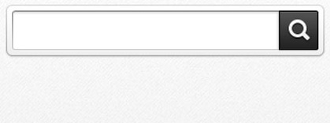
Consistent
Maintain consistent identification of components that have the same functionality.
Search
Find
Notes:
3.2.4 Consistent Identification
Components that have the same functionality within a set of Web pages are identified consistently.
How to achieve:
Consistent use of icons and where they link to
Consistent referential links
Consistent labels, names, and text alternatives for content that has the same functionality
Incorrect example: Calling a search box “search” on the home page, but then referring to it as “find’ on other pages

Slide 43
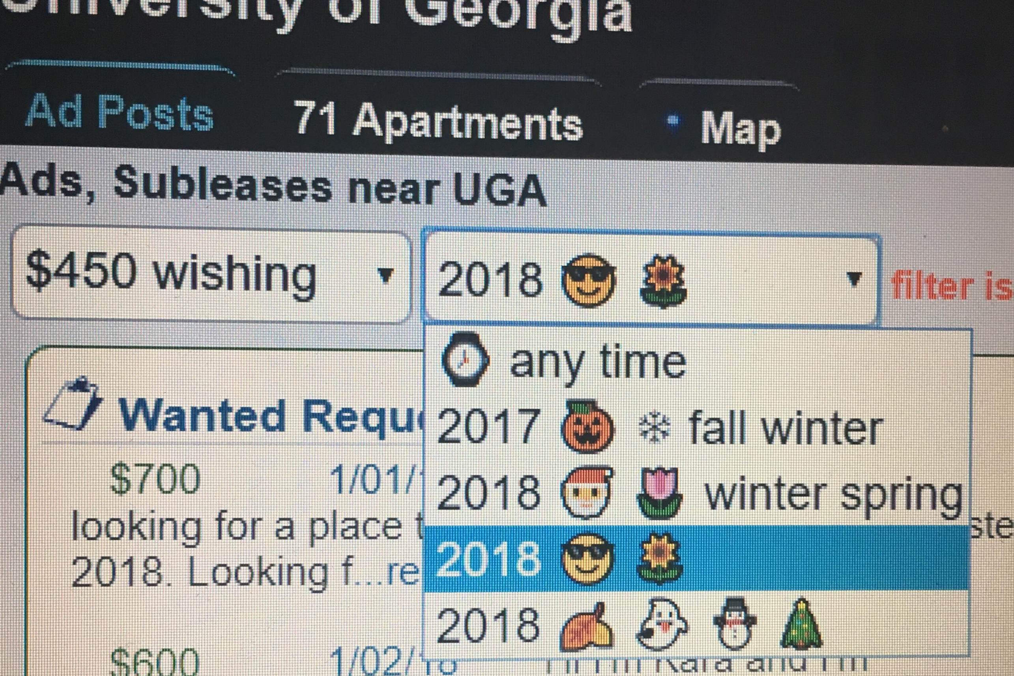
Understandable

Slide 44
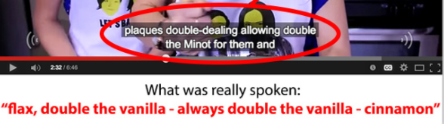
Automated captions
Automated captions are often only 60-70% accuracy
Incorrect captions can cause major issues in a learning
Captioned videos can be indexed and increase SEO.
Notes:
Accuracy is affected by:
Sound quality
Primary language vs secondary language
Complex terms or concepts

Slide 45
Digital Accessibility is a Process NOT a Project!

Slide 46


Keyboard Interactions
All functionality of the content is operable through a keyboard interface without requiring specific timing.
Ability to move to and away from components using a keyboard interface.
Notes:
2.1.1 Keyboard and 2.1.2 No Keyboard trap
How to achieve:
All page functionality is available using the keyboard
Cannot be dependent on a device that require eye-hand coordination e.g. drag and drop actions.
Keep in mind, some users have trouble tracking a pointer or indicator
How to achieve:
Using only a keyboard, you can get to all items on the page.
A “keyboard trap” occurs when a person who uses a keyboard cannot move focus away from an interactive element or control using the keyboard alone

Slide 47
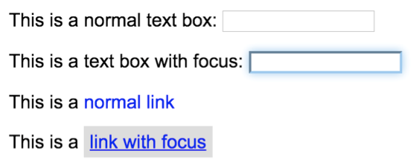
Visible Focus
Notes:
2.4.7 Focus Visible
Any keyboard operable user interface has a mode of operation where the keyboard focus indicator is visible.
But when it receives focus, things don’t happen without notification.
unannounced change could confuse or disorient the user
Links don’t open automatically on focus.
Forms do not submit without user confirming.
No automatic pop-ups.
Focus never jumps automatically.
See also
2.1.1 - Keyboard
2.4.3 – Focus Order

Slide 48
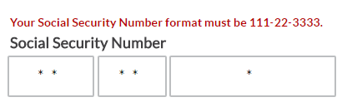
Helpful Form Fields
Instructions
Input
Errors
Suggestions
Notes:
1.3.3 – Sensory Characteristics
1.4.1 – Use of Color
3.3.2 – Labels or Instructions
3.3.3 – Error Suggestion
3.3.4 – Error Prevention (Legal, Financial, Data)
Provide examples for data formats
Provide text instructions at the beginning of a form
How to achieve:
Required data formats
Invalid entry (dates)
Invalid characters
Don’t clear the form if user makes a mistake
Provide client-side validation and alert
Best practice: Provide error notifications before the users continues.
Adding examples to form fields greatly increase the success of the person entering the information.
Phone number examples:
With dashes
Without dashes
Broken out into 3 entry boxes
Include the country code
If you don’t clearly identify how you want the information, your site visitors could experience delays or even frustration.
Errors
How to achieve:
Required data formats
Invalid entry (dates)
Invalid characters
Don’t clear the form if user makes a mistake
Provide client-side validation and alert
Best practice: Provide error notifications before the users continues.

Slide 49



Widgets and Plug-ins
Notes:
Often the widget providers do not include proper coding to make them accessible for assistive technologies.
Developers who use these should make sure the code is fully compliant before deploying on your site.
In some organizations, web services and tool purchased from vendors must met digital accessibility requirements. Examples could be a survey tool or payment system.
Since these sites or tools offer services under your name, your reputation is associated with the user's experience.
You have limited control over updates on vendor site, but you should pursue all channels to get a better product for you and your users.
Document your efforts and re-evaluate providers at contract opportunities.
Example: Embedded YouTube videos with iframes
Calendars
Embedded videos
News feeds
Surveys
Advertisers
Social Media

Slide 50

Cross-Browser compatibility
Notes:
Design works properly and error-free in all browsers
Functions on all platforms
Note: HTML 5 (released 2012) and CSS3 version are still not fully supported by all major browsers (we should be weary of time sensitive statements like this), but offer the most accessible coding options.

Slide 51
Thank you!
Dawn Watkins | Siteimprove
dwat@siteimprove.com

